Slide 1
CSE 246: Algorithms
Course Introduction

Slide 2
Redwan Ahmed Rizvee
Email: redwan.rizvee@ewubd.edu
Contact: 01758545903
BSc, MS : Department of Computer Science and Engineering, University of Dhaka (CSEDU) (Ekush)
Past: Research Scientist at TigerIT Bangladesh Limited

Slide 3
Algorithm ?
Find the order of executing your pending tasks ensuring maximum pay-off
?
What is algorithm ?
Search for a word in dictionary
Computer demands a set of particular ordered instructions
An algorithm is basically a set of ordered well defined instructions to solve a particular problem
Why we need algorithm ?
Finding a home address
Solving wordle, nerdle games

Slide 4
Solution of a Problem
Generic
An algorithm/set of ordered well defined instructions
The complexity of the algorithm
Run time Complexity: The number of instructions need to be executed ( E.g, 1+2+3+..+10)
Memory Complexity: The memory usage (E.g., repeat count in array)
Solution 1
Solutions are never bad, but some solutions are better w.r.t constraints
Solution 2
Problem
Solution 3

Slide 5
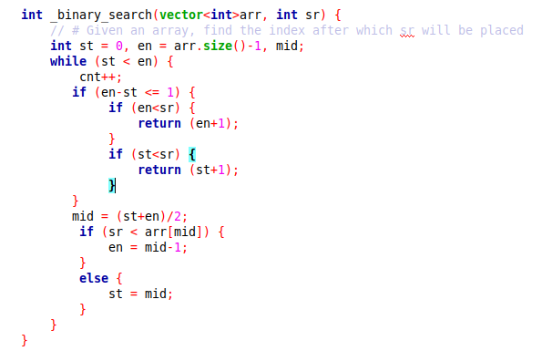
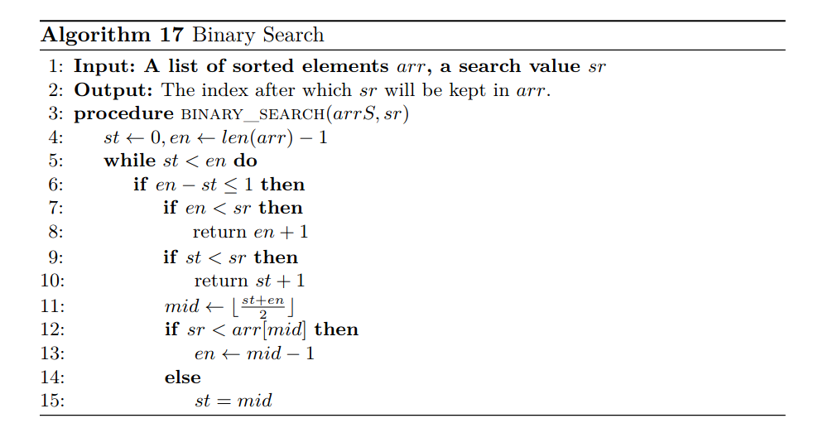
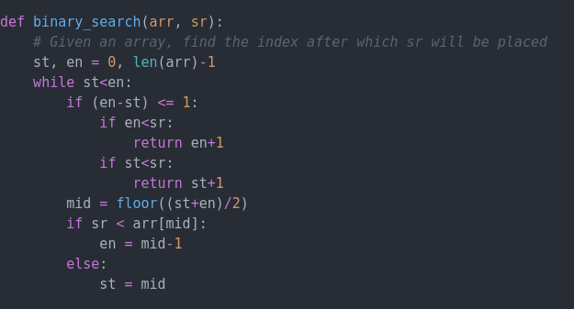
Visualization of Algorithms: Pseudocode

Slide 6
Approach
Learn/Understand an algorithm
Implement it
Solve problems
Read Blogs/Tutorials, Ask friends, But Never Cheat

Slide 7
Visualization of Algorithms: Flowchart
https://www.visual-paradigm.com/tutorials/flowchart-tutorial/

Slide 8
Thank You

